Slide 1
Chapter 8
Variable Selection
Terry Dielman
Applied Regression Analysis:
A Second Course in Business and Economic Statistics, fourth edition
Variable Selection

Slide 2
8.1 Introduction
Previously we discussed some tests (t-test and partial F) that helped us determine whether certain variables should be in the regression.
Here we will look at several variable selection strategies that expand on this idea.
Variable Selection
Copyright © 2005 Brooks/Cole, a division of Thomson Learning, Inc.

Slide 3
Why is This Important?
If an important variable is omitted, the estimated regression coefficients can become biased (systematically too high or low).
Their standard errors can become inflated, leading to imprecise intervals and poor power in hypothesis tests.
Variable Selection
Copyright © 2005 Brooks/Cole, a division of Thomson Learning, Inc.

Slide 4
Strategies
All possible regressions: computer procedures that briefly examine every possible combination of Xs and report summaries of fit ability.
Selection algorithms: rules for deciding when to drop or add variables
    Backwards Elimination
    Forward Selection
    Stepwise Regression
Variable Selection
Copyright © 2005 Brooks/Cole, a division of Thomson Learning, Inc.

Slide 5
Words of Caution
None guarantee you get the right model because they do not check assumptions or search for omitted factors like curvature.
None have the ability to use a researcher's knowledge about the business or economic situation being analyzed.
Variable Selection
Copyright © 2005 Brooks/Cole, a division of Thomson Learning, Inc.

Slide 6
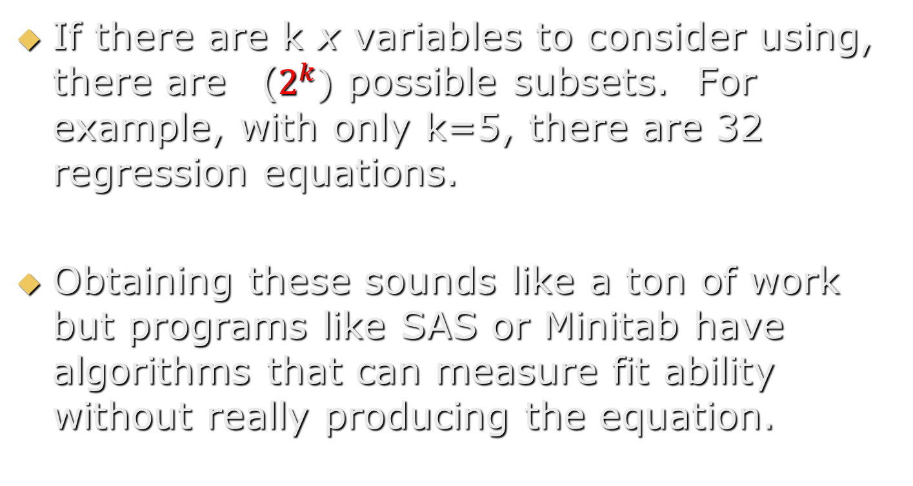
8.2 All Possible Regressions
Variable Selection
Copyright © 2005 Brooks/Cole, a division of Thomson Learning, Inc.

Slide 7
Typical Output
The program will usually give you a summary table.
Each line on the table will tell you which variables were in the model, plus measures of fit ability.
These measures include R², adjusted R², S_{e} and a new one, C_{p}
Variable Selection
Copyright © 2005 Brooks/Cole, a division of Thomson Learning, Inc.

Slide 8
The C_{p} Statistic (Mallow’s Cp)
p = k + 1 is the number of terms in the model, including the intercept.
SSE_{p} is the SSE of this model
MSE_{F} is the MSE in the "full model" (with all the variables)
SSE_{p}
C_{p} = - (n – 2p)
MSE_{F}
Variable Selection
Copyright © 2005 Brooks/Cole, a division of Thomson Learning, Inc.

Slide 9
Using The C_{p} Statistic
Theory says that in a model with bias, C_{p} will be large.
It also says that in a model with no bias, C_{p} should be equal to p.
It is thus recommended that we consider models with a small C_{p} and those with C_{p} near p = k + 1.
Variable Selection
Copyright © 2005 Brooks/Cole, a division of Thomson Learning, Inc.

Slide 10
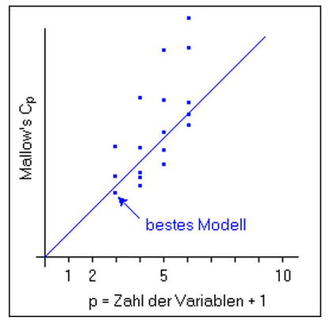

Mallow’s C_{p} Statistic
Variable Selection
Copyright © 2005 Brooks/Cole, a division of Thomson Learning, Inc.

Slide 11
Example 8.1 Meddicorp Revisited
n = 25 sales territories
y = Sales (in $1000s) in each territory
x₁ = Advertising ($100s) in the territory
x₂ = Bonuses paid (in $100s) in the territory
x₃ = Market share in the territory
x₄ = largest competitor's sales ($1000s)
x₅ = Region code (1 = S, 2 = W, 3 = MW)
We are not using region here because it should be converted to indicator variables which should be examined as a group.
Variable Selection
Copyright © 2005 Brooks/Cole, a division of Thomson Learning, Inc.

Slide 12
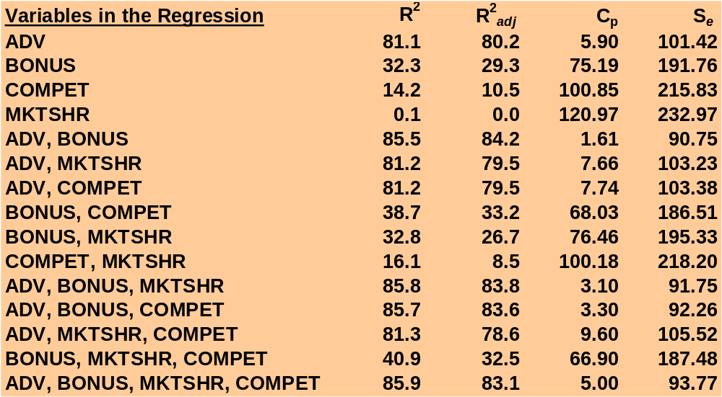
Summary Results For All Possible Regressions
Variable Selection
Copyright © 2005 Brooks/Cole, a division of Thomson Learning, Inc.

Slide 13
The Best Model?
The two variable model with ADV and BONUS has the smallest C_{p} and highest adjusted R².
The three variable models adding either MKTSHR or COMPET also have small C_{p} values but only modest increases in R².
The two-variable model is probably the best.
Variable Selection
Copyright © 2005 Brooks/Cole, a division of Thomson Learning, Inc.

Slide 14
Minitab Results
M C
B K O
O T M
A N S P
D U H E
Vars R-Sq R-Sq(adj) C-p S V S R T
1 81.1 80.2 5.9 101.42 X
1 32.3 29.3 75.2 191.76 X
2 85.5 84.2 1.6 90.749 X X
2 81.2 79.5 7.7 103.23 X X
3 85.8 83.8 3.1 91.751 X X X
3 85.7 83.6 3.3 92.255 X X X
4 85.9 83.1 5.0 93.770 X X X X
By default, the Best Subsets procedure prints two models for each number of X variables. This can be increased up to 5.
Variable Selection
Copyright © 2005 Brooks/Cole, a division of Thomson Learning, Inc.

Slide 15
Limitations
With a large number of potential x variables, the all possible approach becomes unwieldy.
Minitab can use up to 31 predictors, but warns that computational time can be long when as few as 15 are used.
"Obviously good" predictors can be forced into the model, thus reducing search time, but this is not always what you want.
Variable Selection
Copyright © 2005 Brooks/Cole, a division of Thomson Learning, Inc.

Slide 16
8.3 Other Variable Selection Techniques
With a large number of potential x variables, it may be best to use one of the iterative selection methods.
These will look at only the set of models that their rules will lead them too, so they may not yield a model as good as that returned by the all possible regressions approach.
Variable Selection
Copyright © 2005 Brooks/Cole, a division of Thomson Learning, Inc.

Slide 17
8.3.1 Backwards Elimination
Start with all variables in the equation.
Examine the variables in the model for significance and identify the least significant one.
Remove this variable if it does not meet some minimum significance level.
Run a new regression and repeat until all remaining variables are significant.
Variable Selection
Copyright © 2005 Brooks/Cole, a division of Thomson Learning, Inc.

Slide 18
No Search Routine Needed?
Although most software packages have automatic procedures for backwards elimination, it is fairly easy to do interactively.
Run a model, check its t-tests for significance, and identify the variable to drop.
Run again with one less variable and repeat the steps.
Variable Selection
Copyright © 2005 Brooks/Cole, a division of Thomson Learning, Inc.

Slide 19
Step 1 – All Variables
Regression Analysis: SALES versus ADV, BONUS, MKTSHR, COMPET
The regression equation is
SALES = - 594 + 2.51 ADV + 1.91 BONUS + 2.65 MKTSHR - 0.121 COMPET
Predictor Coef SE Coef T P
Constant -593.5 259.2 -2.29 0.033
ADV 2.5131 0.3143 8.00 0.000
BONUS 1.9059 0.7424 2.57 0.018
MKTSHR 2.651 4.636 0.57 0.574
COMPET -0.1207 0.3718 -0.32 0.749
S = 93.77 R-Sq = 85.9% R-Sq(adj) = 83.1%
Least Significant
Variable Selection
Copyright © 2005 Brooks/Cole, a division of Thomson Learning, Inc.

Slide 20
Step 2 – COMPET Eliminated
Regression Analysis: SALES versus ADV, BONUS, MKTSHR
The regression equation is
SALES = - 621 + 2.47 ADV + 1.90 BONUS + 3.12 MKTSHR
Predictor Coef SE Coef T P
Constant -620.6 240.1 -2.58 0.017
ADV 2.4698 0.2784 8.87 0.000
BONUS 1.9003 0.7262 2.62 0.016
MKTSHR 3.116 4.314 0.72 0.478
S = 91.75 R-Sq = 85.8% R-Sq(adj) = 83.8%
Variable Selection
Copyright © 2005 Brooks/Cole, a division of Thomson Learning, Inc.

Slide 21
Step 3 – MKTSHR Eliminated
Regression Analysis: SALES versus ADV, BONUS
The regression equation is
SALES = - 516 + 2.47 ADV + 1.86 BONUS
Predictor Coef SE Coef T P
Constant -516.4 189.9 -2.72 0.013
ADV 2.4732 0.2753 8.98 0.000
BONUS 1.8562 0.7157 2.59 0.017
S = 90.75 R-Sq = 85.5% R-Sq(adj) = 84.2%
Variable Selection
Copyright © 2005 Brooks/Cole, a division of Thomson Learning, Inc.

Slide 22
8.3.2 Forward Selection
At each stage, it looks at the x variables not in the current equation and tests to see if they will be significant if they are added.
In the first stage, the x with the highest correlation with y is added.
At later stages it is much harder to see how the next x is selected.
Variable Selection
Copyright © 2005 Brooks/Cole, a division of Thomson Learning, Inc.

Slide 23
Minitab
Output for
Forward
Selection
An option in the Stepwise procedure
Forward selection. Alpha-to-Enter: 0.25
Response is SALES on 4 predictors, with N = 25
Step 1 2
Constant -157.3 -516.4
ADV 2.77 2.47
T-Value 9.92 8.98
P-Value 0.000 0.000
BONUS 1.86
T-Value 2.59
P-Value 0.017
S 101 90.7
R-Sq 81.06 85.49
R-Sq(adj) 80.24 84.18
C-p 5.9 1.6
Variable Selection
Copyright © 2005 Brooks/Cole, a division of Thomson Learning, Inc.

Slide 24
Same Model as Backwards
This data set is not too complex, so both procedures returned the same model.
With larger data sets, particularly when the x variables are correlated among themselves, results can be different.
Variable Selection
Copyright © 2005 Brooks/Cole, a division of Thomson Learning, Inc.

Slide 25
8.3.3 Stepwise Regression
A limitation with the backwards procedure is that a variable that gets eliminated is never considered again.
With forward selection, variables entering stay in, even if they lose significance.
Stepwise regression corrects these flaws. A variable entering can later leave. A variable eliminated can later go back in.
Variable Selection
Copyright © 2005 Brooks/Cole, a division of Thomson Learning, Inc.

Slide 26
Minitab
Output for
Stepwise
Regression
Alpha-to-Enter: 0.15 Alpha-to-Remove: 0.15
Response is SALES on 4 predictors, with N = 25
Step 1 2
Constant -157.3 -516.4
ADV 2.77 2.47
T-Value 9.92 8.98
P-Value 0.000 0.000
BONUS 1.86
T-Value 2.59
P-Value 0.017
S 101 90.7
R-Sq 81.06 85.49
R-Sq(adj) 80.24 84.18
C-p 5.9 1.6
Variable Selection
Copyright © 2005 Brooks/Cole, a division of Thomson Learning, Inc.

Slide 27
Selection Parameters
For backwards elimination, the user specifies "Alpha to Remove", which is the maximum p-value a variable can have and stay in the equation.
For forward selection, the user specifies "Alpha to Enter", which is the minimum p-vale a variable needs to enter the equation.
Stepwise regression gets both.
Often we use values like .15 or .20 because this encourages the procedures to look at models with more variables.
Variable Selection
Copyright © 2005 Brooks/Cole, a division of Thomson Learning, Inc.

Slide 28
8.4 Which Procedure is Best?
Unless there are too many x variables, the all possible models approach is favored because it looks at all combinations of variables.
Of the other strategies, stepwise regression is probably best.
If no search programs are available, backwards elimination can still provide a useful sifting of the data.
Variable Selection
Copyright © 2005 Brooks/Cole, a division of Thomson Learning, Inc.

Slide 29
No Guarantees
Because they do not check assumptions or examine the model residuals, there is no guarantee of returning the right model.
Nonetheless, these can be effective tools filtering the data and identifying which variables to pay more attention to.
Variable Selection
Copyright © 2005 Brooks/Cole, a division of Thomson Learning, Inc.

Slide 30

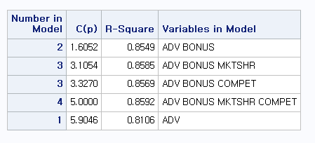
proc reg data=a ; model sales = ADV BONUS
MKTSHR COMPET / selection = ? ;
selection = rsquare adjrsq aic cp
forward backward stepwise ;
selection = cp best=4 ;
Variable Selection
Copyright © 2005 Brooks/Cole, a division of Thomson Learning, Inc.

Slide 31
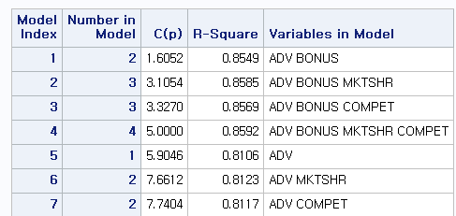
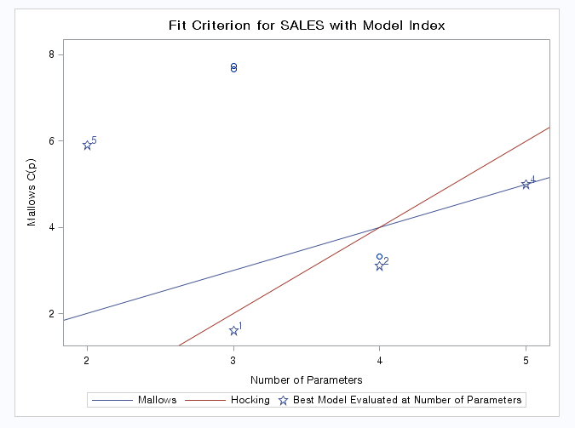
Mallows’ Cp in SAS
Mallows (1973) says Cp ~ p and small
Hocking (1976) says Cp <= 2p – (k+1)
Variable Selection
Copyright © 2005 Brooks/Cole, a division of Thomson Learning, Inc.

Slide 32
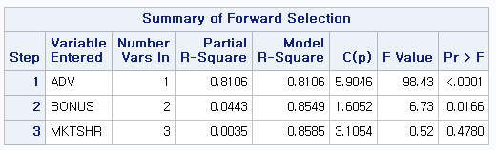
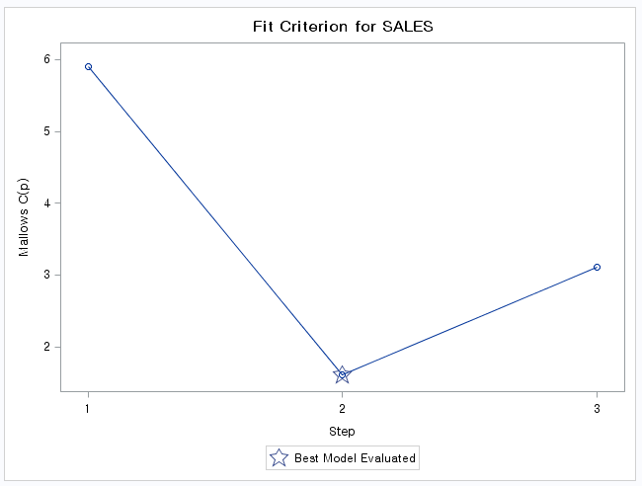
Forward Selection in SAS
selection = forward ;
Partial F-test
with alpha=0.5
SLE = 0.5
(significance level for entry)
Variable Selection
Copyright © 2005 Brooks/Cole, a division of Thomson Learning, Inc.

Slide 33
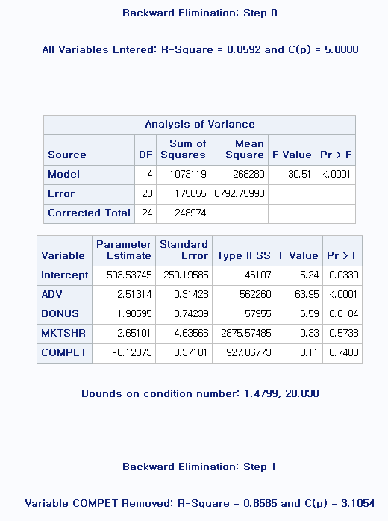
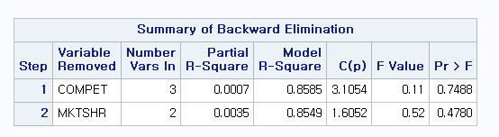
Backward Elimination in SAS
selection = backward ;
Partial F-test
with alpha=0.1
SLS = 0.1
(significance level for stay)
Variable Selection
Copyright © 2005 Brooks/Cole, a division of Thomson Learning, Inc.

Slide 34
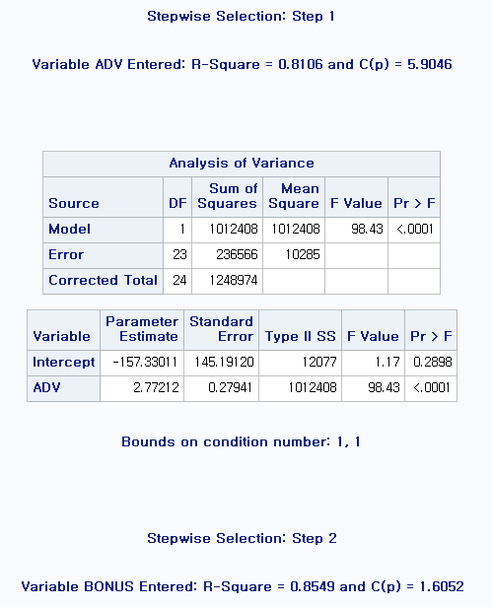
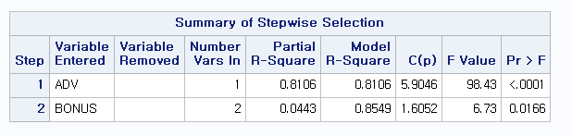
Stepwise Regression in SAS
selection = stepwise ;
Variable Selection
Copyright © 2005 Brooks/Cole, a division of Thomson Learning, Inc.

